Slide 1




Telecom Churn Prediction
Presented By :- Ritika Khadilkar

Slide 2


Agenda
About telecom churn prediction
Our Mission and vision
Our Goals
Our Milestones
Challenges
Data Cleaning & Preprocessing
ML Model Building
Hyperparameter Tuning
Logistic & Confusion Matrix
Conclusion

Slide 3

Telecom Churn Prediction
Telecom churn prediction involves using data analytics and machine learning to forecast which customers are likely to leave a telecommunications service provider. By analyzing customer behavior and demographics, companies can identify at-risk customers and implement strategies to retain them, thereby reducing turnover and improving customer satisfaction.

Slide 4

Goals
Identify At-Risk Customers
Enhance Customer Retention
Reduce Costs
Lower the expenses associated with acquiring new customers by focusing on retaining existing ones
Develop and implement targeted strategies to retain these at-risk customers.
Accurately predict which customers are likely to leave the telecommunications service.

Slide 5

Our Vision And Mission
Mission
We aim to use advanced data analytics and machine learning to predict when customers might leave our service. By doing so, we can implement personalized strategies to keep them happy, reduce the number of customers who switch to other providers, and operate more efficiently overall
Vision
Create a telecommunications environment focused on customers, using predictive insights to anticipate customer needs. This approach will help us keep customers loyal and ensure our business continues to grow

Slide 6

Milestones
Data gathering & understanding the dataset
Collect and comprehend the dataset to be used.
Data Cleaning and Pre-processing
Clean and prepare the data for analysis.
Machine Learning model building
Develop and train machine learning models.
Hyperparameter Tuning& Confusion Matrix
Optimize model parameters and evaluate performance using Confusion Matrix.

Slide 7

Challenges
Data Quality and Integration: Integrating and maintaining high-quality data from diverse sources like customer demographics, call logs, and billing information is complex but essential for accurate predictions.
Imbalanced Datasets: Telecom datasets often have a small percentage of churning customers compared to those who stay, leading to biased models and inaccurate predictions.
Dynamic Customer Behavior: Customer preferences and behaviors change frequently, making it difficult to build predictive models that can adapt to these evolving patterns.
Scalability: Churn prediction systems need to handle massive volumes of data and serve large customer bases, requiring robust and scalable solutions.
Real-Time Prediction: Implementing systems that provide real-time churn predictions requires fast data processing and decision-making capabilities to enable timely interventions.

Slide 8

Data Cleaning And Preprocessing
Convert data type of variable which are Misclassified
Removing Unique value variable
Removing Duplicate Value
Removing Zero Variance variable

Slide 9

Data Cleaning And Preprocessing
Convert data type of variable which are Misclassified
Outliers Treatment
Removing the highly Corelated Value
Missing Value Treatment
Multicolli-nearity (VIF>5)

Slide 10
Machine learning Model Building
Logistic Regression
Decision Tree
Random Forest

Slide 11
Logistic Regression
Logistic regression is a statistical method used to predict the likelihood of an event occurring, where the outcome is binary (e.g., yes/no). It calculates the probability of the event by fitting a line to the data and using the logistic function to ensure the predicted probability is between 0 and 1.
"Logistic regression is essential for predicting binary outcomes, providing clear results, probabilistic predictions, efficiency, and serving as a basis for more complex models."

Slide 12
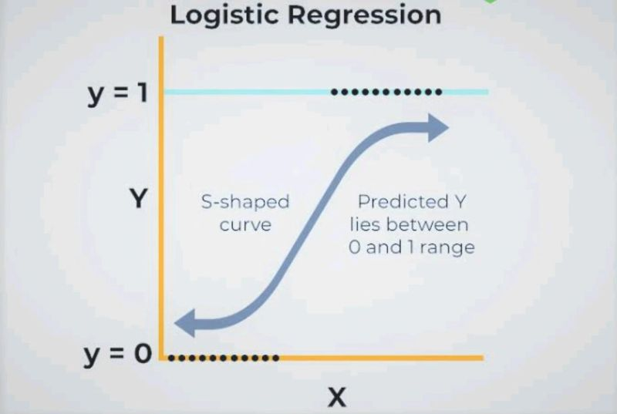
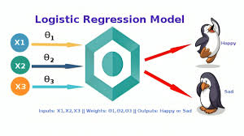
Logistic Regression Algorithm

Slide 13
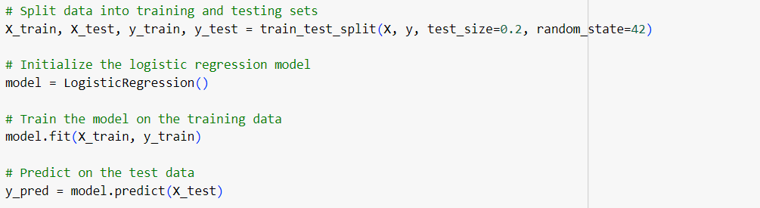
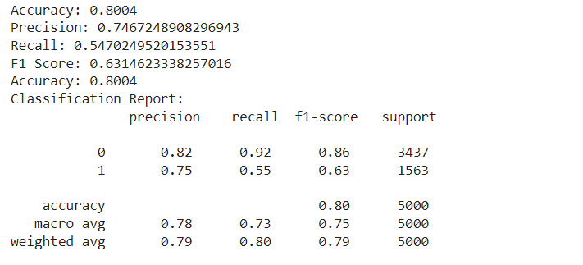
CODE SNIPPET

Slide 14
Decision Tree
A decision tree is a supervised learning algorithm that partitions data into subsets based on feature values. It constructs a tree-like structure where each internal node represents a decision based on a feature, leading to branches corresponding to different outcomes. Decision trees are used for classification and regression tasks, known for their interpretability and ability to handle various data types effectively. They aim to create splits that reduce impurity or variance, making them versatile tools in machine learning.

Slide 15
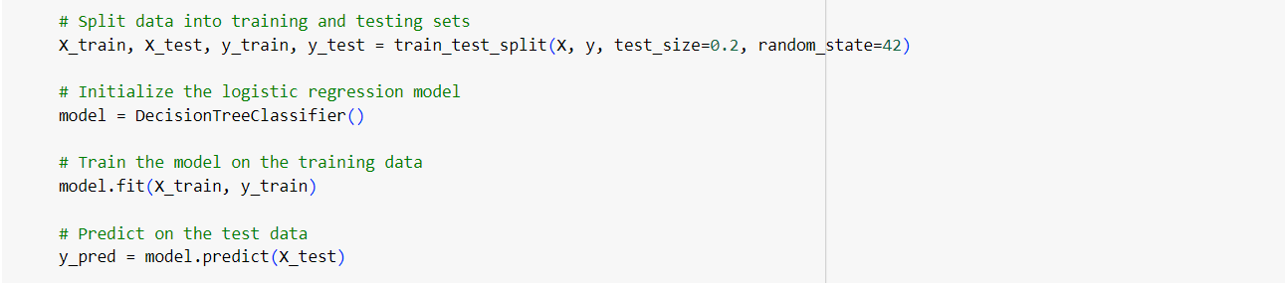
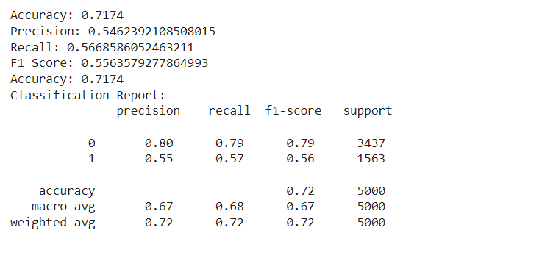
CODE SNIPPET

Slide 16
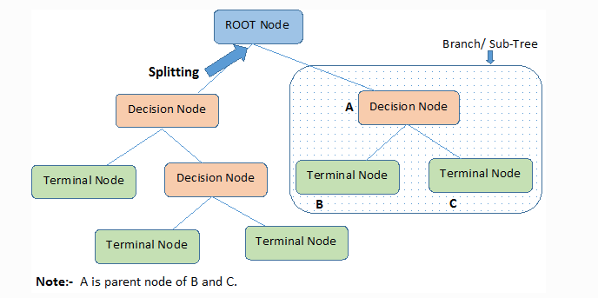
Decision Tree Algorithm

Slide 17
Random Forest
Random Forest is an ensemble learning method that builds multiple decision trees during training and outputs the average prediction (regression) or the mode (classification) of the individual trees. It uses randomness in both data sampling and feature selection to improve accuracy and reduce overfitting, making it robust and effective across various datasets and tasks in machine learning.

Slide 18
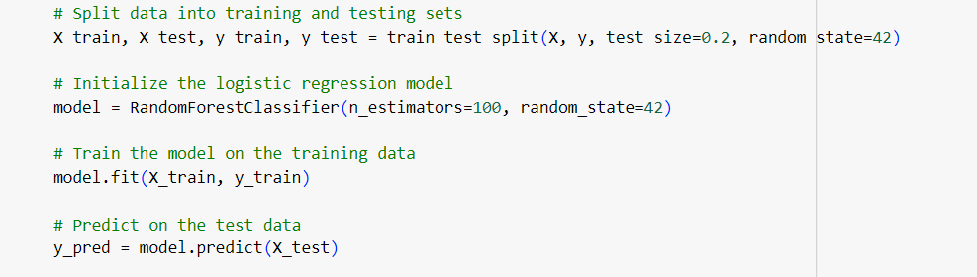
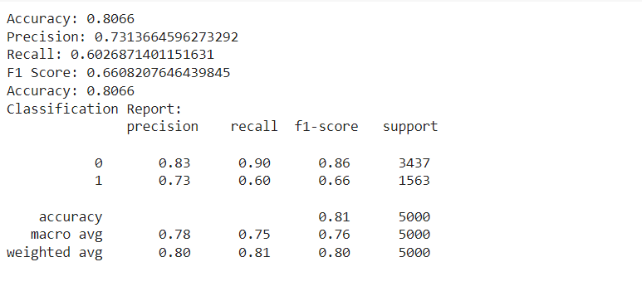
CODE SNIPPET

Slide 19
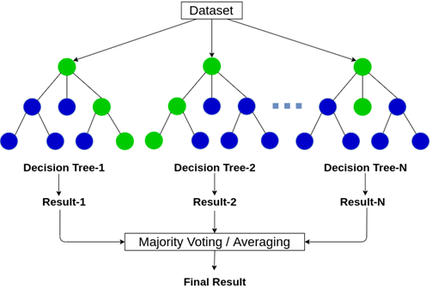
Random Forest Algorithm

Slide 20
Hyperparameter Tuning
Hyperparameter optimization is the process of determining the ideal configuration for a machine learning model to enhance its performance. This involves tweaking parameters that govern the learning process, such as the number of trees in a Random Forest or the learning rate in a neural network. By experimenting with various parameter combinations, we identify those that provide the best results for our particular dataset.

Slide 21
IMPORTANCE
Improves Model Performance: Proper tuning enhances predictions and accuracy
Prevents Overfitting and Underfitting: Balances complexity to avoid learning noise or missing patterns.
Optimizes Learning Process: Adjusts parameters for efficient, effective training.
Adapts to Different Datasets: Customizes settings for better generalization.
Enables Complex Models: Essential for optimizing deep neural networks.

Slide 22
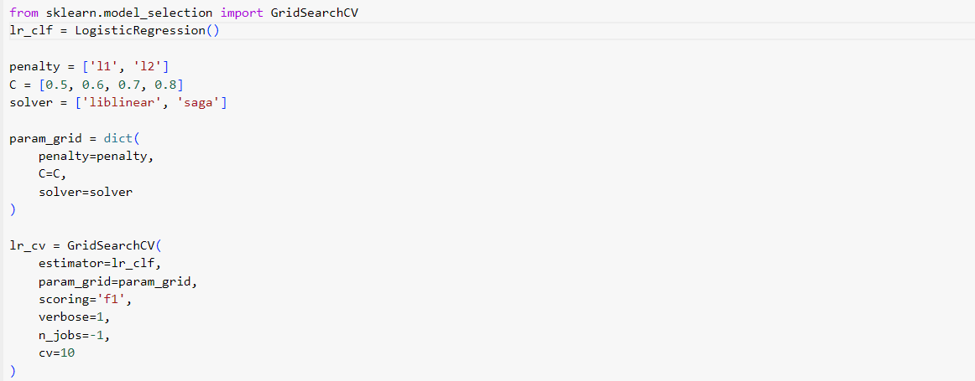
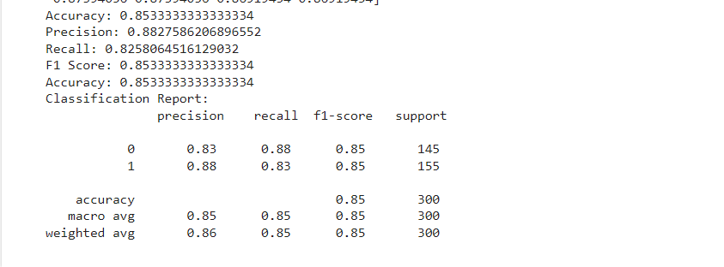
CODE SNIPPET

Slide 23
Key Difference
Parameter | Logistic Regression | Decision Tree
Precision | 0.80 | 0.82
Recall | 0.78 | 0.87
F1-Score | 0.79 | 0.84
Random Forest
0.83
0.90
0.86

Slide 24
Best Fit Model
Why Logistic Regression?
Logistic regression is a preferred model for churn prediction due to its simplicity, interpretability, and efficiency, providing clear insights into how each feature impacts churn probability. It handles binary outcomes and large datasets well, making it easy to understand and communicate results to stakeholders. Despite its simplicity, logistic regression often yields good accuracy by effectively modeling the relationship between customer features and churn likelihood while avoiding overfitting, especially with regularization techniques. After evaluating Random Forest, Decision Tree, and Logistic Regression, the latter demonstrated superior performance, high accuracy, and a minimal gap between training and testing accuracy. This indicates robust generalization to unseen data, ensuring reliable and interpretable results, unlike the overfitting issues seen in more complex models.

Slide 25
Confusion Matrix
A confusion matrix is a table used to evaluate a classification model's performance by comparing actual and predicted values. It consists of True Positives (TP), True Negatives (TN), False Positives (FP), and False Negatives (FN), helping to measure the model's accuracy, precision, recall, and F1-score, and highlighting misclassification errors.

Slide 26
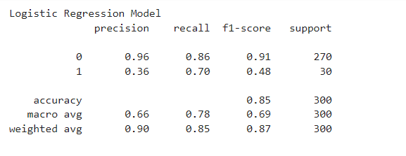
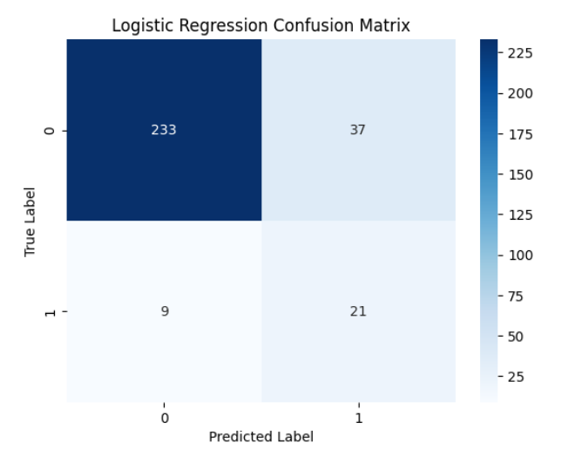
CODE SNIPPET

Slide 27
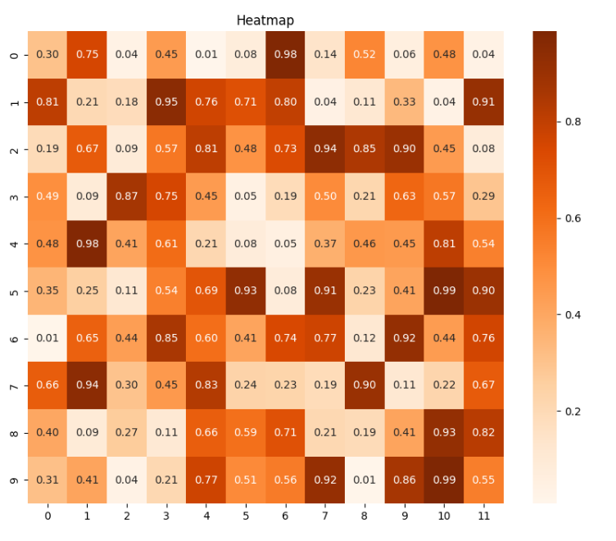
Heat Map
A heat map is a data visualization technique that uses color gradients to represent the magnitude of values in a matrix, making it easier to identify patterns, correlations, and outliers. It is commonly used to display complex data sets in a visually intuitive manner.

Slide 28
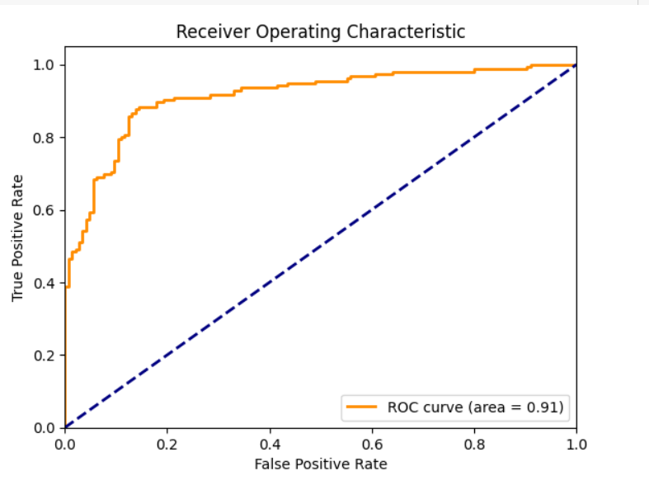
Roc Curve
Receive Operating Characteristics
The ROC curve (Receiver Operating Characteristic curve) is a graphical representation of a classifier's performance, plotting the true positive rate against the false positive rate at various threshold settings. It is used to evaluate the trade-offs between sensitivity and specificity and to compare the diagnostic ability of different models.

Slide 29
Conclusion
Enhanced Customer Retention: Predicting which customers are likely to churn allows telecom companies to implement strategies that keep valuable customers satisfied and loyal.
Cost Savings: Preventing churn is more cost-effective than acquiring new customers, allowing for better resource allocation and reduced expenses associated with customer loss.
Improved Customer Experience: Understanding customer behavior and preferences enables telecom providers to offer tailored experiences, address concerns proactively, and significantly enhance overall satisfaction.
Increased Revenue: Keeping existing customers and maximizing their lifetime value ensures steady revenue streams and supports sustainable business growth.
Competitive Edge: Effective churn prediction and management give telecom companies an advantage through superior service, personalized offers, and proactive retention strategies.

